Slide 1

Obedience
AEPSY Year 11 ATAR Psychology

Slide 2
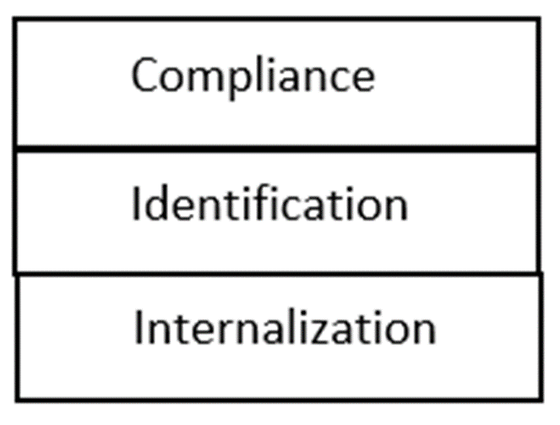
Review
Compare the two aspects of social influence theory.
List the three processes or levels of influence.
Explain informed consent and withdrawal rights.
Why is compliance not effective at changing beliefs or attitudes?
What are the four pillars of child development?

Slide 3
Learning Intentions
obedience
social response to authority
study: Behavioural study of obedience (Milgram, 1963)

Slide 4
Success Criteria
Define obedience
Summarise Milgrim’s Behavioural Obedience Study.
Explain why psychologists can only study behaviour.

Slide 5
Obedience
Changing behaviour in response to a direct order by an authority figure.
Occurs within a hierarchy – each level of the hierarchy following the commands of those authority figures ‘higher up’.
Usually motivated by avoidance of punishment, or because they have strong beliefs in the authority figure.

Slide 6


Slide 7
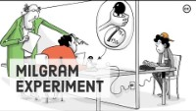

Slide 8
Success Criteria
Define obedience
Summarise Milgrim’s Behavioural Obedience Study.
Explain why psychologists can only study behaviour.

